Slide 1

SMTP
SERVER
Trabajo individual Redes II

Slide 2


Índice
01
02
03
HISTORIA
COMANDOS
CÓDIGO
Introducción y orígenes
Comandos y paso por el rfc
Muestra del código y resumen de implementación
2000

Slide 3
01
HISTORIA
Origen del smtp

Slide 4

60s Predecesors
-> Las primeras referencias son de los 60’s
-> Mailbox usados en MIT pioneros
-> Intercambio de mensajes dentro de un mismo terminal
-> No existen las redes o direcciones

Slide 5

ARPANET
El primer email entre distintos terminales data de 1971, a través de ARPANET, una res del ejército de los Estados Unidos

Slide 6
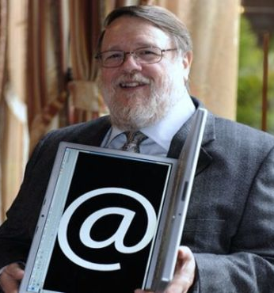
Ray Tomlinson
Conocido como el inventor del email, fue el creador del primer cliente de correo.
También originó el integral email attribute (@) para especificar usuarios en una máquina (user@computer)

Slide 7
AWESOME SMTP

Slide 8
02
COMANDOS RFC
Breve paso por el rfc y los comandos

Slide 9
RFC
Transport of Electronic Mail
The objective of the Simple Mail Transfer Protocol (SMTP) is to transfer mail reliably and efficiently.
SMTP is independent of the particular transmission subsystem and requires only a reliable ordered data stream channel. While this document specifically discusses transport over TCP, other transports are possible. Appendices to RFC 821 [1] describe some of them.
An important feature of SMTP is its capability to transport mail across multiple networks, usually referred to as "SMTP mail relaying" (see Section 3.6). A network consists of the mutually-TCP-accessible hosts on the public Internet, the mutually-TCP-accessible hosts on a firewall-isolated TCP/IP Intranet, or hosts in some other LAN or WAN environment utilizing a non-TCP transport-level protocol. Using SMTP, a process can transfer mail to another process on the same network or to some other network via a relay or gateway process accessible to both networks. In this way, a mail message may pass through a number of intermediate relay or gateway hosts on its path from sender to ultimate recipient. The Mail eXchanger mechanisms of the domain name system (RFC 1035 [2], RFC 974 [12], and Section 5 of this document) are used to identify the appropriate next-hop destination for a message being transported.
1.2. History and Context for This Document
This document is a specification of the basic protocol for the Internet electronic mail transport. It consolidates, updates and clarifies, but does not add new or change existing functionality of the following:
…
It obsoletes RFC 821, RFC 974, RFC 1869, and RFC 2821 and updates RFC 1123 (replacing the mail transport materials of RFC 1123). However, RFC 821 specifies some features that were not in significant use inthe Internet by the mid-1990s and (in appendices) some additional transport models. Those sections are omitted here in the interest of clarity and brevity; readers needing them should refer to RFC 821. It also includes some additional material from RFC 1123 that required amplification. This material has been identified in multiple ways,mostly by tracking flaming on various lists and newsgroups and problems of unusual readings or interpretations that have appeared as the SMTP extensions have been deployed. Where this specification moves beyond consolidation and actually differs from earlier documents, it supersedes them technically as well as textually.

Slide 10

RFC
Transport of Electronic Mail
The objective of the Simple Mail Transfer Protocol (SMTP) is to transfer mail reliably and efficiently.
SMTP is independent of the particular transmission subsystem and requires only a reliable ordered data stream channel. While this document specifically discusses transport over TCP, other transports are possible. Appendices to RFC 821 [1] describe some of them.
An important feature of SMTP is its capability to transport mail across multiple networks, usually referred to as "SMTP mail relaying" (see Section 3.6). A network consists of the mutually-TCP-accessible hosts on the public Internet, the mutually-TCP-accessible hosts on a firewall-isolated TCP/IP Intranet, or hosts in some other LAN or WAN environment utilizing a non-TCP transport-level protocol. Using SMTP, a process can transfer mail to another process on the same network or to some other network via a relay or gateway process accessible to both networks. In this way, a mail message may pass through a number of intermediate relay or gateway hosts on its path from sender to ultimate recipient. The Mail eXchanger mechanisms of the domain name system (RFC 1035 [2], RFC 974 [12], and Section 5 of this document) are used to identify the appropriate next-hop destination for a message being transported.
1.2. History and Context for This Document
This document is a specification of the basic protocol for the Internet electronic mail transport. It consolidates, updates and clarifies, but does not add new or change existing functionality of the following:
…
It obsoletes RFC 821, RFC 974, RFC 1869, and RFC 2821 and updates RFC 1123 (replacing the mail transport materials of RFC 1123). However, RFC 821 specifies some features that were not in significant use inthe Internet by the mid-1990s and (in appendices) some additional transport models. Those sections are omitted here in the interest of clarity and brevity; readers needing them should refer to RFC 821. It also includes some additional material from RFC 1123 that required amplification. This material has been identified in multiple ways,mostly by tracking flaming on various lists and newsgroups and problems of unusual readings or interpretations that have appeared as the SMTP extensions have been deployed. Where this specification moves beyond consolidation and actually differs from earlier documents, it supersedes them technically as well as textually.

Slide 11

HELO
Sirve para identificarse, le dice al pc hola wenas tardes soy <domain>

Slide 12

MAIL FROM
Indicas nueva transacción al servidor.
Tras el from <source>

Slide 13

RCPT
Indicas a quienes va dirigido el mensajes.
(No sabía que meme poner rianse pls)

Slide 14

DATA
Aquí pones lo que quieras mandar en el correo

Slide 15
ESMP
EXTENDED

Slide 16


ESMTP
Parte extendida del prótocolo.
Comandos como EHLO en lugar de HELO.
(EHLO similar pero devuelve comandos compatibles)
También hay auth login, etc.

Slide 17


Slide 18
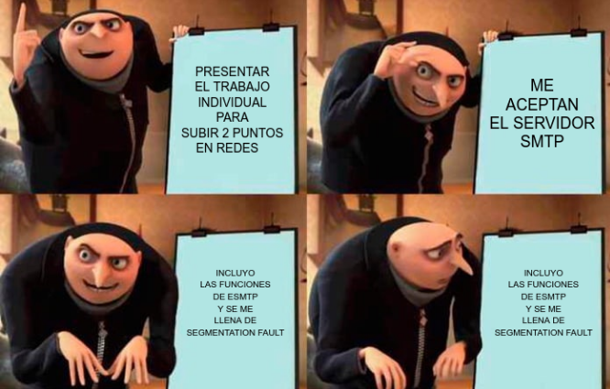

Slide 19
03
CóDIGO
El código

Slide 20
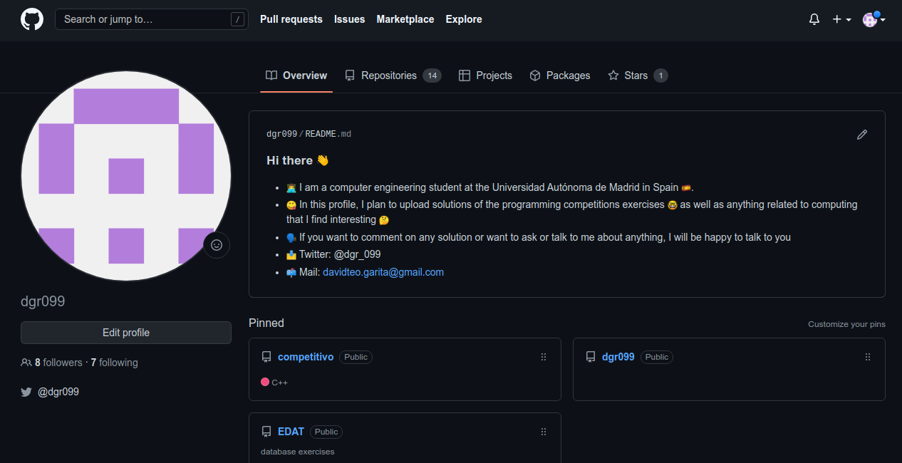

Slide 21
SIGUEME PLS
LUEGO DOY FOLLOW BACK (͡ ͡° ͜ つ ͡͡°)

Slide 22
TRES MÓDULOS
SMTP
MODULE
MAIL
MODULE
USER
Inicia el servidor y lo prepará todo con los sockets y tal,, en cuanto tenga un accept, le pasa el trabajo sucio a module_mail.cpp
Basicamente STRCPY para ver que está enviando el cliente y actuar en consecuencia (helo, mail from…)
Comprueba el usuario para que tanto receptor como emisor existan (Si lo hubiera hecho tendría también cositas del esmtp)

Slide 23
CODE
DEMONSTRATION

Slide 24

CRÉDITOS:
-> GRAPHIC DESIGNER: DAVID T. GARITAGOITIA ROMERO.
-> CODER: DAVID T.
GARITAGOITIA ROMERO.
-> RESEARCHER: DAVID T. GARITAGOITIA ROMERO.
->INTERPRETER: DAVID T. GARITAGOITIA ROMERO.

Slide 25
SIGUEME EN GITHUB 2@ AVISO
(ง ͠° ͟ل͜ ͡°)ง

